Slide 1
INTRODUCTION TO SCRUM
OVERVIEW OF SESSION GOALS
Understand the fundamentals of Scrum.
Learn the key roles, events and artifacts.
Get familiar with tools we’ll use (Miro, Jira, Confluence, Trello, Slack, Google Docs).

Slide 2
OVERVIEW OF SESSION GOALS CON’T
WHAT IS SCRUM?
Scrum is a framework that helps team work together. Like a sports team practicing for a big game, Scrum encourages teams to learn through experiences, self-organize while working on a problem, and reflect on their wins and losses to continuously improve.
Scrum relies heavily on a collaborative approach where team members work together, take responsibility for their tasks, and work in small, manageable units (iterations) to make consistent progress.

Slide 3
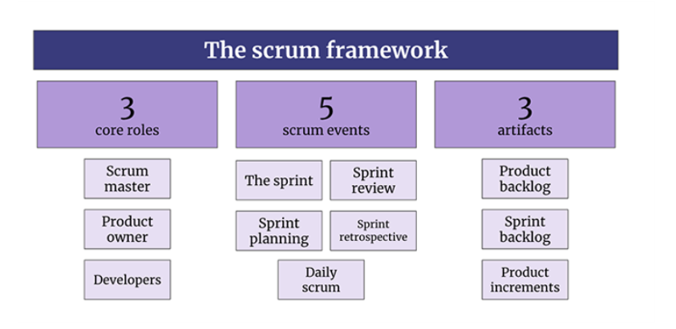
SCRUM FRAMEWORK
Source: DobreTech Portal

Slide 4
SCRUM ROLES
Scrum Team
A scrum team has between 5 to 9 people, but scrum projects can easily scale into the hundreds.(source: DobreTech)
Scrum Master
Ensures the scrum process is followed and helps the team work smoothly. He removes obstacles.
Product Owner
Defines product features and priorities. Represents customer needs and goals. He is responsible for the Product Backlog.
Developer or Technical Team
Builds and tests the product according to the requirements and specifications.

Slide 5
SCRUM EVENTS
Daily Scrum (15mins)
A short daily meeting where the team discusses progress and plans for the day.
Sprint
A time-boxed period, usually 2-4weeks, where the team works on specific tasks.
Sprint Planning (2-4hours)
A meeting at the start of the sprint to plan what work will be done
Sprint Review (1-2hours)
A meeting at the end of the sprint to demonstrate and inspect the work done.
Sprint Retrospective (1-2hours)
A meeting after the sprint to reflect on the process and improve.

Slide 6
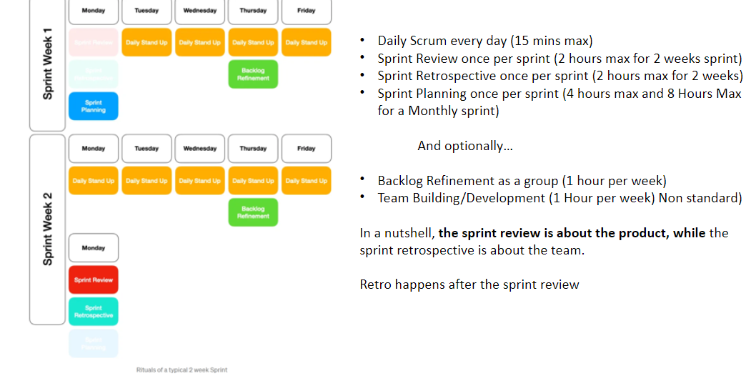
CON’T
Source: DobreTech Portal

Slide 7
SCRUM ARTIFACTS
Product Backlog
A prioritized list of all the features and tasks for the product
Sprint Backlog
A list of tasks selected from the current product backlog for the current sprint
Product Increment
The completed work from the sprint that adds value to the product.

Slide 8





TOOLS OVERVIEW
Miro: Online whiteboard for brainstorming
Jira: Task and project tracking tool.
Trello: Visual project management tool.
Confluence: Documentation and collaboration tool.
Google Docs: Collaborative document editing.
Slack: For communication

